Slide 1
From Scratch to Fine-Tuning: The Evolution of Deep Learning
An overview of the journey from custom model training to leveraging pre-trained models

Slide 2

Deep Learning
What impacts where the arrow will go?
Distance from target
Force of draw
Height from ground
Angle with respect to ground/target
Wind speed
Coriolis effect
Rotation of the earth
…
$$x=−1.2+0.07Force+2.7Distance∗x_{angle}∗z_{angle}$$
$$y=2.7+2.2Force+9.7Distance∗y_{angle}∗z_{angle}$$

Slide 3
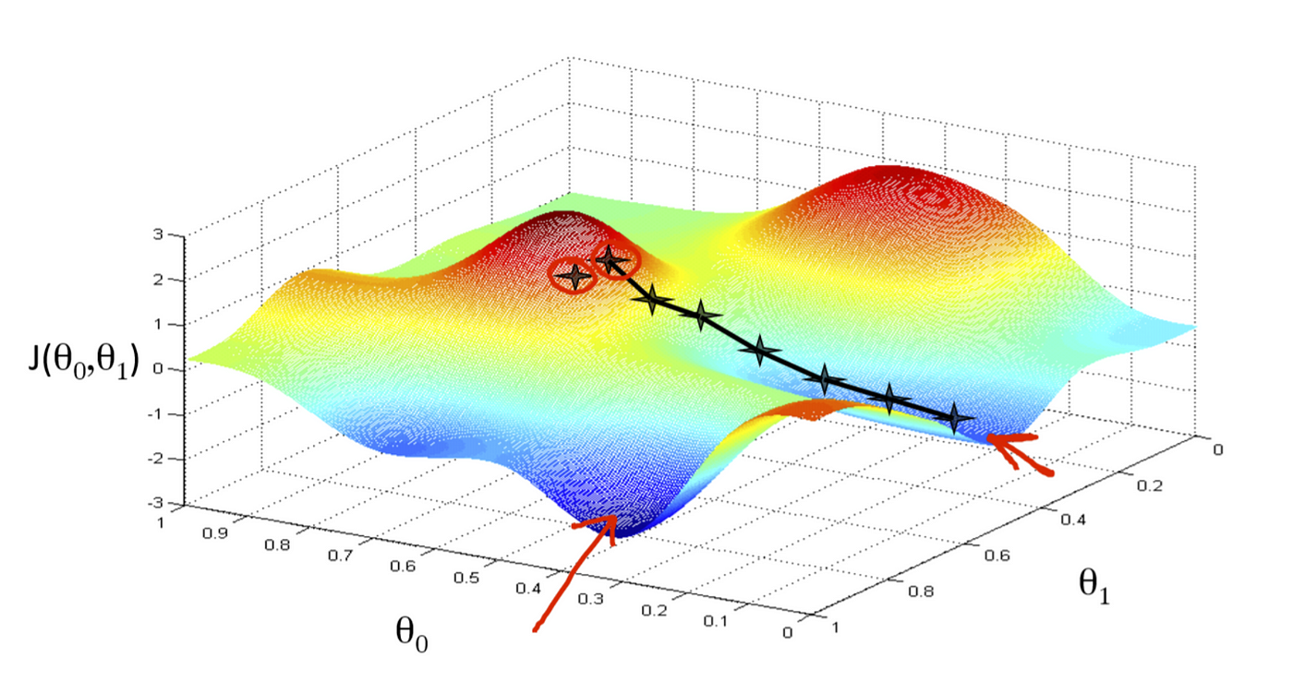
Optimization
Change the parameters until we minimize the times the model is wrong (or maximize the negative)

Slide 4
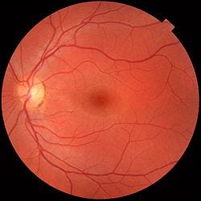
Deep Learning
Male
Female
Humans?
AI?

Slide 5
Deep Learning
Male
Female
Humans: No better than the flip of a coin
AI?

Slide 6
Deep Learning
Male
Female
Humans: No better than the flip of a coin
AI: 97% Accurate

Slide 7
Deep Learning
$$x= + Force+ Distance∗x_{angle}∗z_{angle}$$
Modern AI uses ~500 billion parameters
~ 4,121 on 8.5 x 11 paper
~ 121,340,662 sheets of paper
~ 485,362.648 inches tall (@ 0.004 inches/sheet)
= 40,446.887 feet or 7.67 miles high
Taller than Everest/Deeper than the Mariana Trench

Slide 8
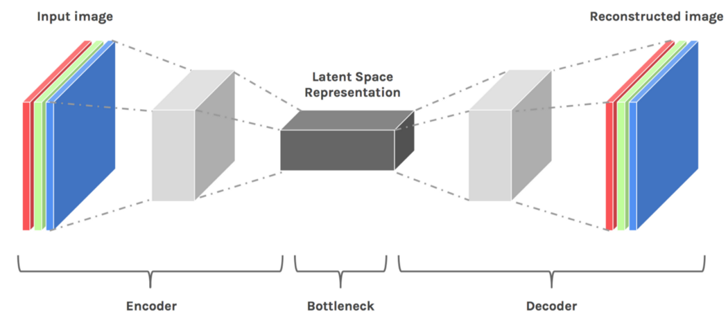
Latent Representations
Car
Human
Trashcan

Slide 9
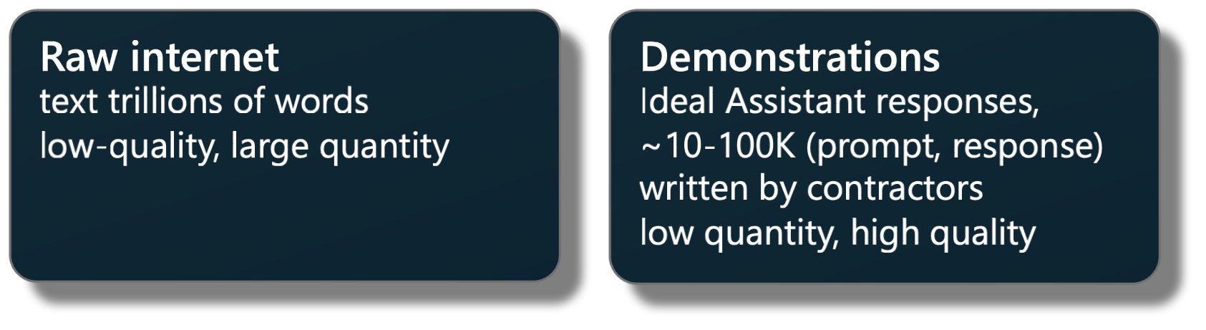
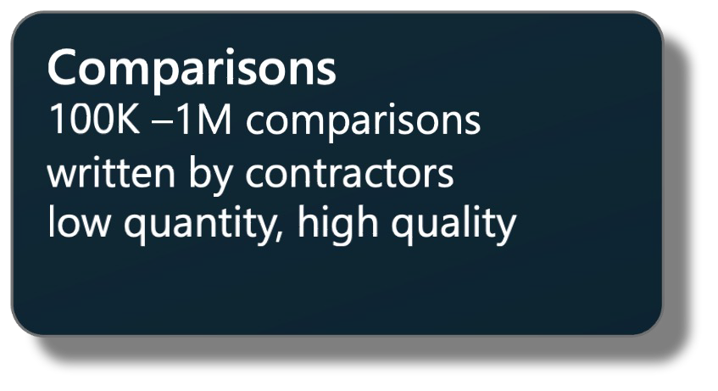
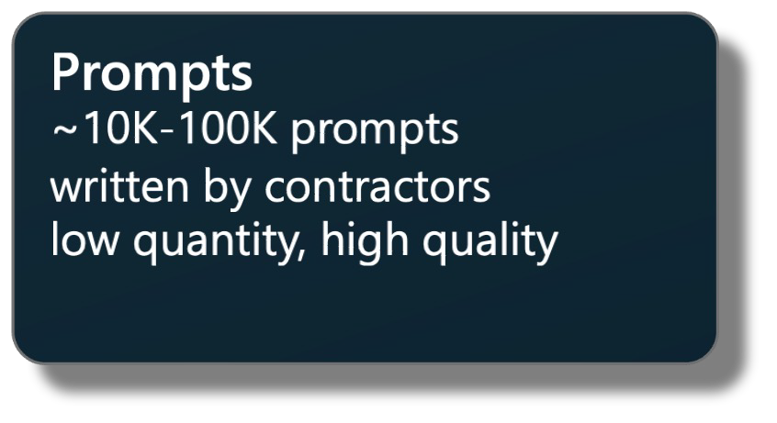
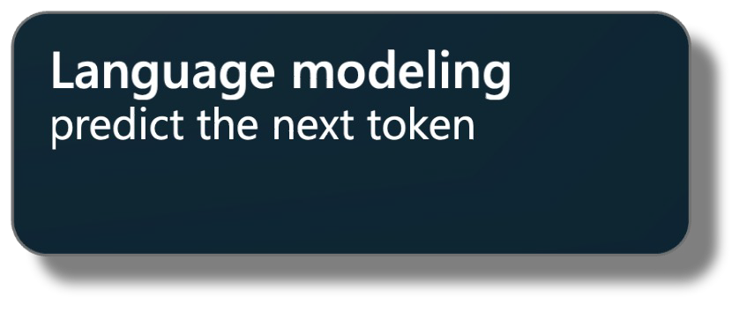
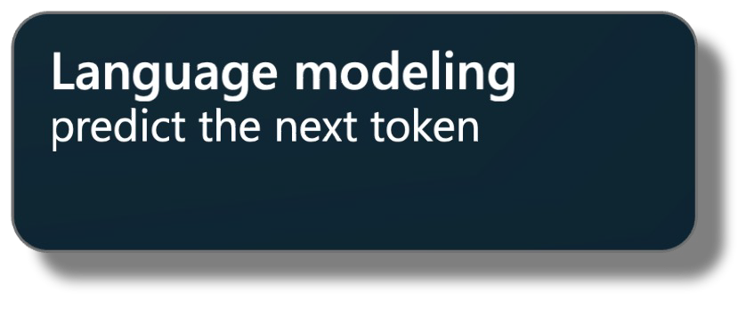
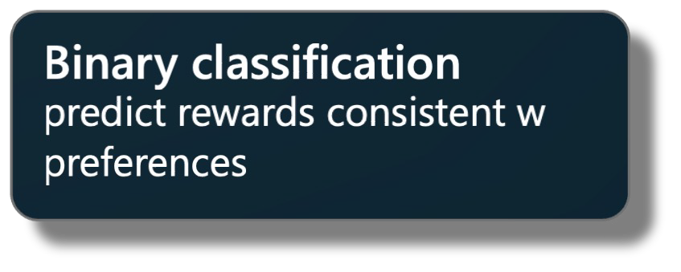
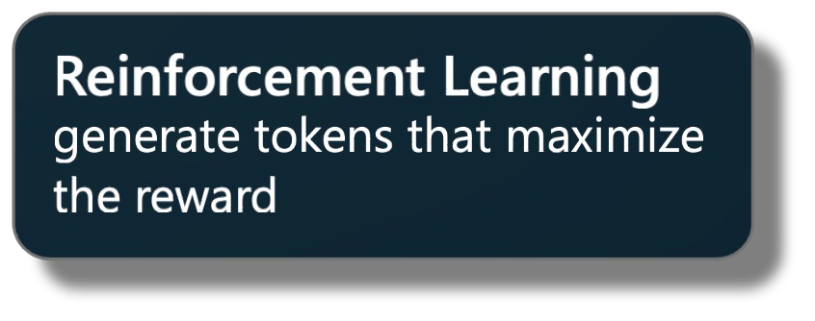
ChatGPT Training Pipeline
Pretraining Supervised Finetuning Reward Modeling
Reinforcement Learning
Dataset
Algorithm
Notes:
Pretraining is 99% of training

Slide 10
Pretraining Data
CommonCrawl
Extensive collection of internet data.
Proportion: 67.0%
Size: 3.3 TB
C4
Cleaned Common Crawl data.
Proportion: 15.0%
Size: 783 GB
Github
Code repositories and discussions.
Proportion: 4.5%
Size: 328 GB
Wikipedia
Description: Free encyclopedia articles.
Proportion: 4.5%
Size: 83 GB
Books
Diverse collection of books.
Proportion: 4.5%
Size: 85 GB
ArXiv
Academic preprint papers.
Proportion: 2.5%
Size: 92 GB
StackExchange
Q&A platform for professionals.
Proportion: 2.0%
Size: 78 GB

Slide 11

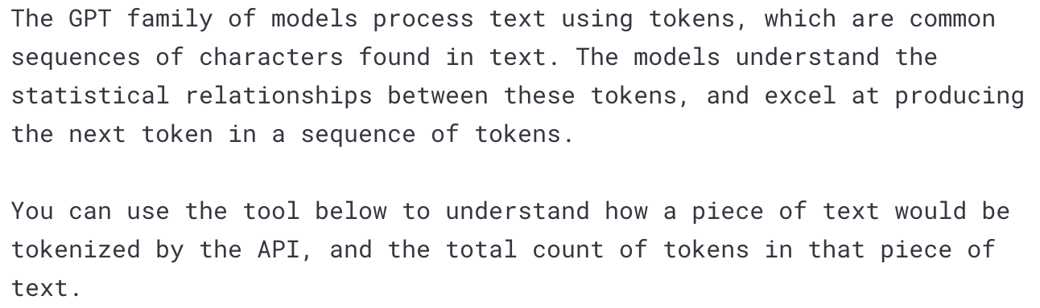
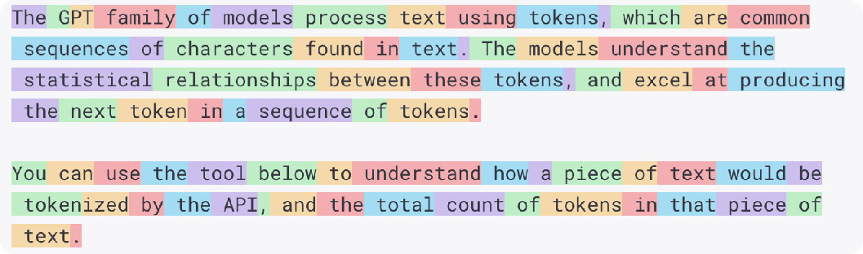

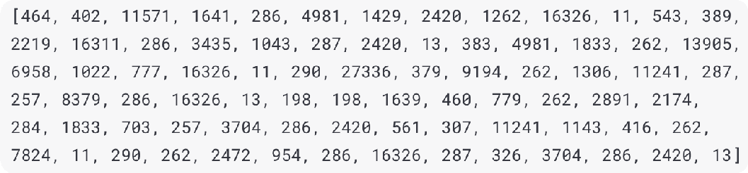



Tokenization
Raw text
Transform all text into one very long list of integers.
Tokens
Typical numbers:
~10-100K possible tokens 1 token ~= 0.75 of word
Typical algorithm:
Byte Pair Encoding
Integers

Slide 12
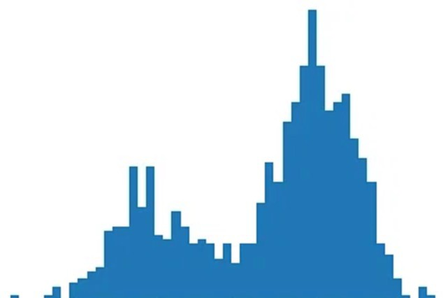
Pretraining
Training sequences are laid out as rows, delimited by special <|endoftext|> tokens
Each cell only ”sees” cells in its row, and only cells before it (on the left of it), to predict the next cell (on the right of it)
50,257 numbers
(probabilities for the next token) correct index (label): 513
Row 1: Here is an example document 1 showing some tokens.
Row 2: Example document 2<|endoftext|>Example document 3<|endoftext|>Example document
Row 3: This is some random text just for example<|endoftext|>This
Row 4: 1,2,3,4,5
Green = a random highlighted token
Yellow = its context
Red = its target
4342 | 318 | 281 | 1672 | 3188 | 352 | 4478 | 617 | 16326 | 13
16281 | 3188 | 362 | 50256 | 16281 | 3188 | 513 | 50256 | 16281 | 3188
1212 | 318 | 617 | 4738 | 2420 | 655 | 329 | 1672 | 50256 | 1212
16 | 11 | 17 | 11 | 18 | 11 | 19 | 11 | 20 | 11

Slide 13

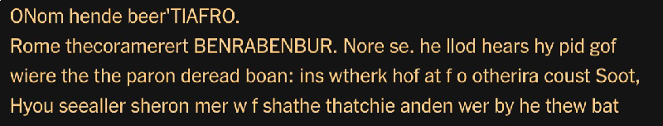


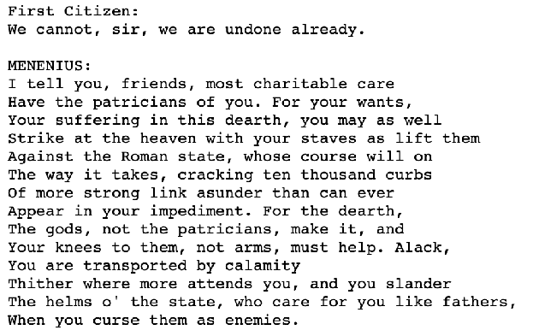

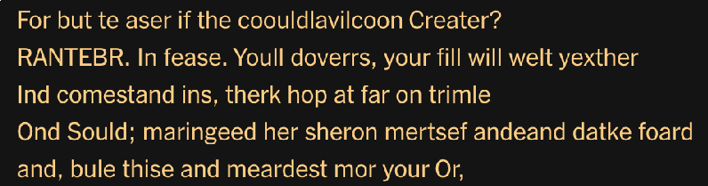

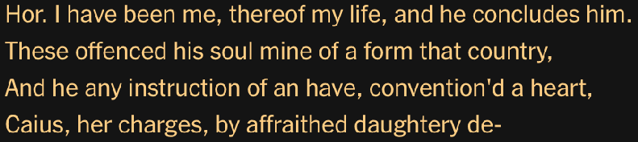

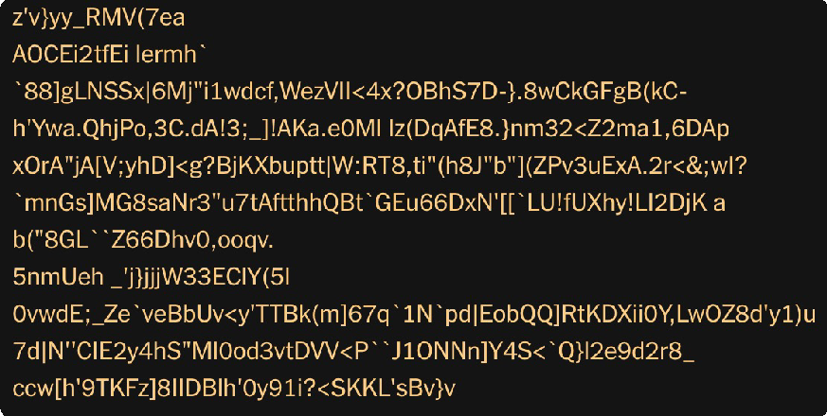

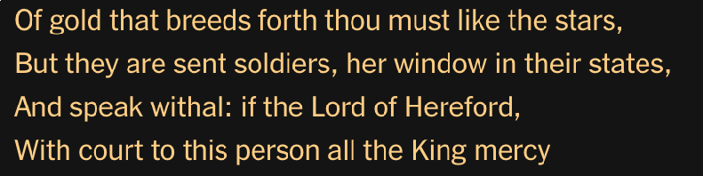


Training Process
Samples after 250 iterations of training
Training data (Shakespeare)
Samples after 500 iterations of training
Samples after 5,000 iterations of training
Samples at initialization
Samples after 30,000 iterations of training

Slide 14
Latent Representations
Car
Human
Trashcan

Slide 15
Fine Tune for different objective

Slide 16
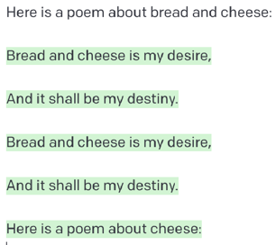
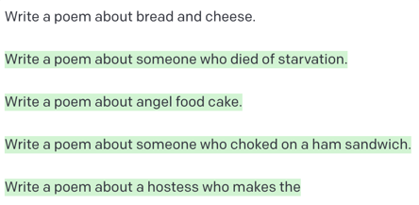
Base Models
・ Base model does not answer questions
・ It only wants to complete documents
・ Often responds to questions with more questions, etc.:
It can be tricked into performing tasks with prompt engineering:

Slide 17
Let’s Practice!

Slide 18
ChatGPT Training Pipeline
Pretraining Supervised Finetuning Reward Modeling
Reinforcement Learning
Dataset
Algorithm
Notes:
Pretraining is 99% of training

Slide 19




Fine Tune on Conversations
Prompt:
"Can you write a short introduction about the relevance of the term "monopsony" in economics? Please use examples related to potential monopsonies in the labour market and cite relevant research."
Response:
""Monopsony" refers to a market structure where there is only one buyer for a particular good or service. In economics, this term is particularly relevant in the labor market, where a monopsony employer has significant power over the wages and working conditions of their employees. The presence of a monopsony can result in lower wages and reduced employment opportunities for workers, as the employer has little incentive to increase wages or provide better working conditions. Recent research has identified potential monopsonies in industries such as retail and fast food, where a few large companies control a significant portion of the market (Bivens & Mishel, 2013). In these industries, workers often face low wages, limited benefits, and reduced bargaining power, leading to a situation where they are dependent on the employer for their livelihood. This dependence can result in further suppression of wages and a decline in working conditions. Overall, the concept of monopsony is essential to understanding the dynamics of labor markets and the impact of market power on workers.
Further research is needed to understand the extent and impact of monopsonies on the economy and to develop policies to address this issue. References: Bivens, J., & Mishel, L. (2013). The Pay of Corporate Executives and Financial Professionals as Evidence of Rents in Top 1 Percent Incomes.
Journal of Economic Perspectives, 27(3), 57-78."

Slide 20
ChatGPT Training Pipeline
Pretraining Supervised Finetuning Reward Modeling
Reinforcement Learning
Dataset
Algorithm
Notes:
Pretraining is 99% of training

Slide 21
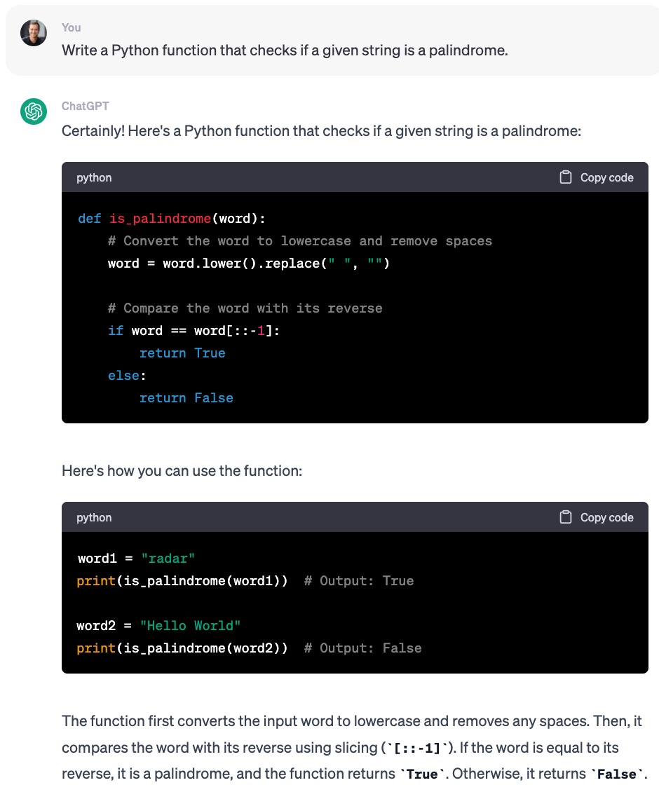
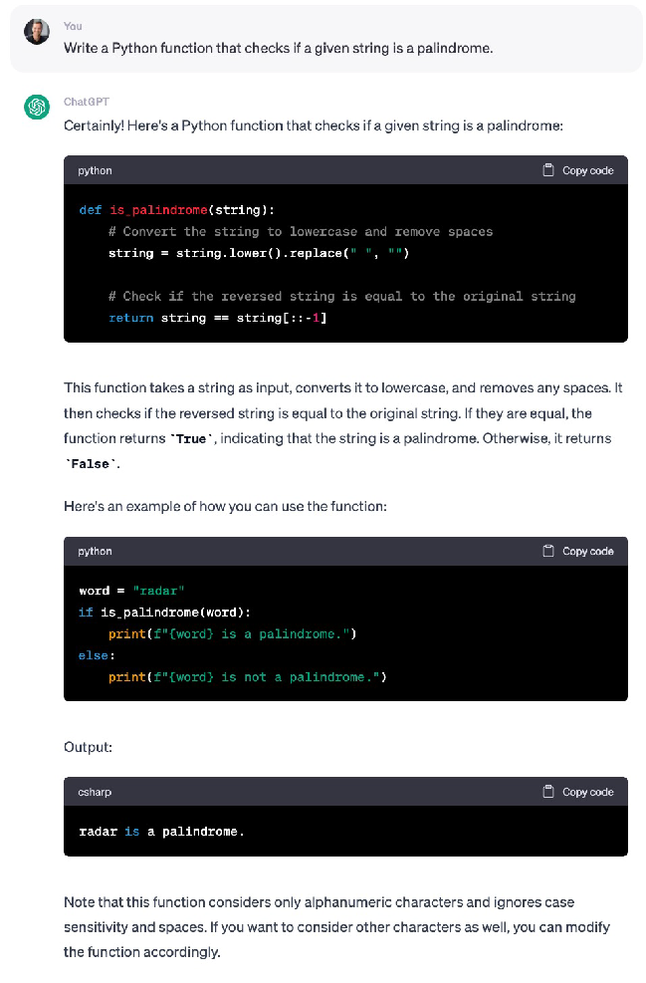
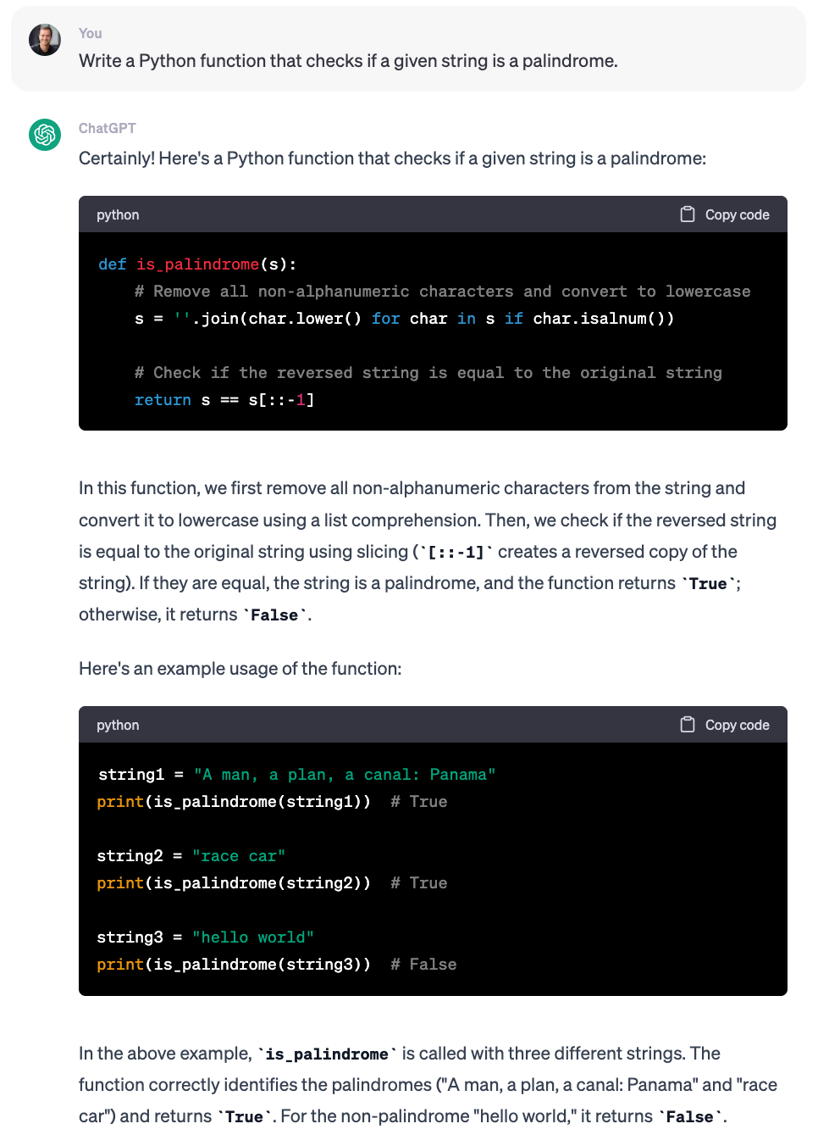



What’s the “best” answer?

Slide 22



What’s the “best” answer?
3
2
1
Notes:
Train a separate “reward”model on how a human might prefer the responses

Slide 23
ChatGPT Training Pipeline
Pretraining Supervised Finetuning Reward Modeling
Reinforcement Learning
Dataset
Algorithm
Notes:
Pretraining is 99% of training

Slide 24
Reinforcement Learning
Give better weighting to better responses
1.8
Row 1 was great, boost probabilities
Row 2 was bad, decrease probabilities
Row 3 was ~eh, slightly boost probabilities
-0.7
0.5
prompt | … |  | response 1 |  |  | [reward]
prompt | … |  | response 2 |  |  |  |  |  | [reward]
prompt | … |  | response 3 |  | [reward]

Slide 25
What’s Next?

Slide 26
LLMs are doomed
Auto-Regressive LLMs are doomed.
• They cannot be made factual, non-toxic, etc.
• They are not controllable
• Probability e that any produced token takes us outside of the set of correct answers
• Probability that answer of length n is correct:
P(correct)=(1−e)^n
Errors accumulate
It’s not fixable (without a major redesign).

Slide 27
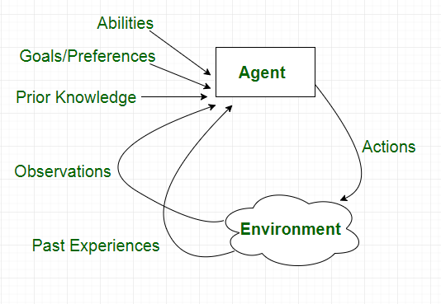
What’s Next?
Autonomous Agents
Longer-running, high-level tasks that require reasoning

Slide 28
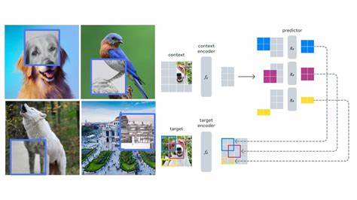
Enhanced World Models

Slide 29
Thank you!

